Slide 1
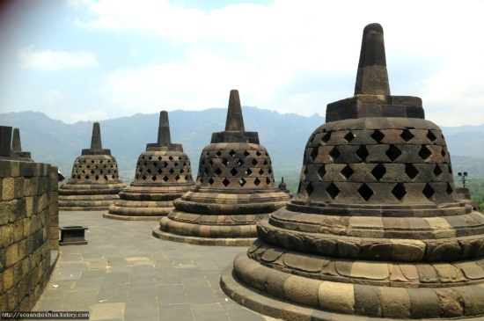
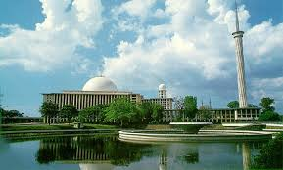
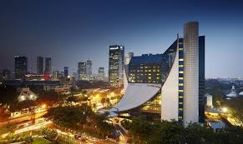

TVET System in Korea
(Technical Vocational Education & Training)
Oct. 13, 2016

Slide 2


Slide 3

Introduction
Introduction

Slide 4
1. Economic Development_Export Goods
5 year Economic Development Plan

Slide 5


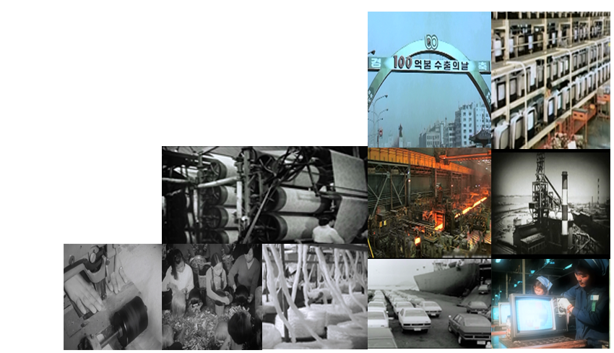
Success of 3rd & 4th
5yr. Economic Development
(1972~1981)
Petroleum & Chemistry
Success of 1st & 2nd
5yr. Economic Development
(1962~1971)
Heavy Industry
Labor Intensive

Slide 6
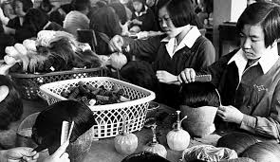
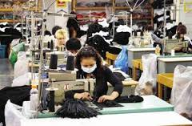
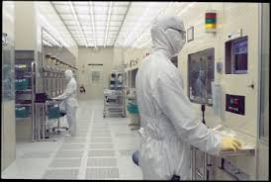
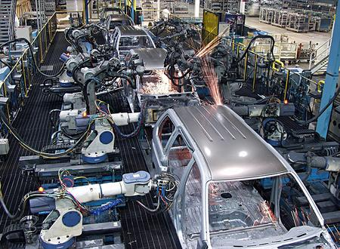
Comparing 1960 vs 2014
→ Korea, one of the least developed countries in terms of
industrial development in the early 60s
→ Transformed into one of leading industrial countries
in the world during the last 50 years
Year | 1960 | 2014
GDP per capita | U$ 82 | U$ 28,180
Share of Manufacturing(GDP) | 14.4% | 49.0% (2010)
Major Industries | Wig Eyelashes Plywood Clothes | Ship building(World #2) Automobile(World #5) Semiconductor(Wd.#2) Steel Making(Wd.#5)

Slide 7
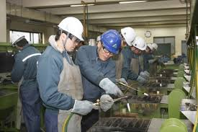
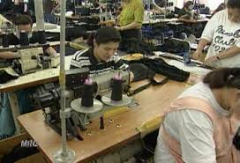

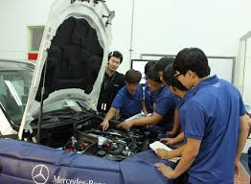
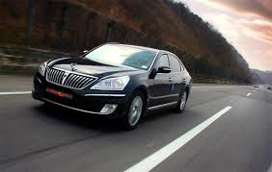
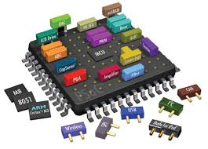
Cultivation of Qualified Manpower
5 yr Plan | Year | Manpower
1st ~ 2nd | 1962~1971 | Apprentice
3rd ~ 4th | 1972~1981 | Mono Skilled
5th ~ 6th | 1982~1991 | Multi Skilled
7th ~ 8th | 1992~2001 | Technicians
9th ~10th | 2002~2011 | Technologist
11th ~ | 2012~2016 | Engineer
12th ~ | 2016~ | Scientist

Slide 8
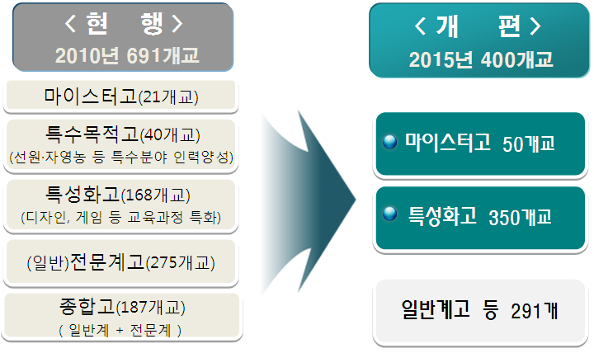
Providers of VET
Vocational Education
Vocational Training
Postgraduate
In-house Tech. College
In-house education institute / Education institute of authorities / Others
Undergraduate
(4-6y)
Industrial Univ.
(4y)
Educational Univ.
(4y)
Correspondence College
(4y)
Technical College
Vocational College
(2-3y)
Technical Univ.
(2y)
Technical academy
General High School
(3y)
Vocational High School
(3y)
Correspondence High School
∧
3
y
∨
High school affiliated with company and special class
High Tech. School
∧
1
ㅣ
3
y
∨
Other schools
∧
1
ㅣ
3
y
∨
Vocational Training Institute
Public Vocational Training Institute
In-house Vocational Training Institute
Certified Vocational Training Institute
Agricultural High School
Technical High School
Commercial High School
Fisheries/Maritime High
School
Comprehensive High
School
[Specialized High School]
Meister High School
(Special Purpose High
School)
Vocational Course
(1y)
Middle School (3y)
Middle school affiliated with company
Highr Civic Sch.
Other Sch.
<Vocational High School Reorganization Plan>
<As Is>
692 schools (As of 2010)
<To Be>
400 schools (by 2015)
Elementary School (6y)
Civic Sch.
Meister high schools (21)
Special purpose high schools (40)
(Fostering human resources in special areas, such as sailing and farming)
Meister high schools (50)
Specialized vocational high schools (168)
(Specialized curriculum, such as design and game)
Specialized vocational high schools (350)
Kindergarten
(General) Vocational high schools (275)
Comprehensive high schools (187)
(General – Vocational)
General high schools and others (291)

Slide 9
Major No. of Schools/Students
Classification |  | No. of Schools | No. of Students (thousand)
Primary | Elementary Sch. | 5,829 | 4,869
Secondary | Middle Sch. | 3,106 | 1,975
 | General HS | 1,534 | 1,485
 | Vocational HS | 692 | 480
Tertiary | Junior College | 138 | 720
 | University | 201 | 2,173

Slide 10
Advanced Rates to the Next Stage Education
[Unit : %]
※ SAECE is needed for the tertiary sector entrance. [ Scholastic Achievement Examination for College Entrance]
Description | 1970 | 1980 | 1990 | 2000 | 2010
Elem. S → Middle S | 66.1 | 95.8 | 99.9 | 99.9 | 99.9
Middle S → High S | 70.1 | 84.5 | 95.7 | 99.5 | 99.6
High S → Tertiary | 23.2 | 24.6 | 33.2 | 68.0 | 79.0

Slide 11
Increasing of Univ. & Students

Slide 12
Aligning HRD with Labor Demand
Efficient supply of industrial workforce based on labor demand
 | State-led Industrialization |  |  | Democratization 1987~1997 | Globalization 1997~present
 | 1961~1973 | 1973~1980 | 1980~1987
Economy | Light Industrialization Export Promotion Policy initiated | Heavy & Chemical Industrialization | Economic Stabilization | Economic Liberalization Economic Slowdown | Industrial Restructuring after Economic Crisis IT-centered Industrial Upgrading Globalization
Education & HRD | Statist Educational System Expansion of Primary Education | Expansion of Middle school Education Expansion of Vocational Training | Expansion of Univ. & College | Educational Reform of Statist Educational System Autonomy & Diversity Universalization of College Education | Educational Globalization Graduate School Education (BK21) National HRD University-Industry Partnership

Slide 13
TVET System
TVET System

Slide 14
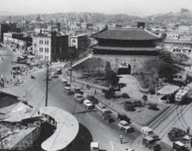
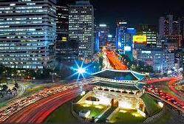
Comparing 1960 vs 2000
Seoul downtown in 1960’s
Seoul downtown in 2000’s
Source: Google image by web search

Slide 15

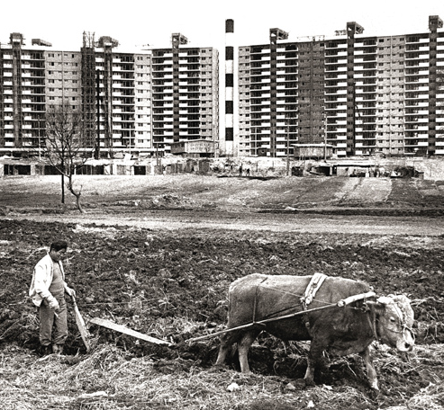
Comparing 1970 vs 2000
GangNam Area in 1970
GangNam Area in 2000
Source: Google image by web search

Slide 16
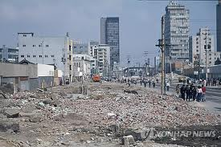
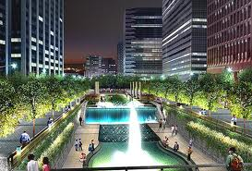
Comparing 1960s’ vs 2000
Seoul downtown in 1970’s
Seoul downtown in 2000’s
Source: Goole image by web search 2012

Slide 17
History of HRD/TVET
1967 Vocational Training Act
1968 1st VTI established
1978 24VTIs’ established
1980 Open Masters College
1994 Open18 Masters’s Colleges
1996 Renamed
21 VTS
1998 KOPO Established
2006 Open 43 Polytechnics
1990 Open KUTE

Slide 18
The Status of VTIs’
Classification |  | No. | Remarks
Total |  | 7,177
Public VTIs | Sub-Total | 79
 | Public Org. | 40 | KOPO, KUT, KEPAD
 | Local Govern. | 8 | Seoul, Other Provinces
 | Min. of Justice | 31 | Inmates’ Vocational Competency
Private VTIs | Sub-Total | 7,098
 | Trg. Corporation | 55 | Non-profit Corporations
 | WRD Center | 51 | Women’s Vocational Competency
 | MOEL Designated | 823 | Individual Designated VTIs, KCCI
 | Others | 6,169 | Companies or Associations, etc.
[REMARKS]
KOPO : Korea Polytechnics
KUT : Korea University of Technology and Education
KCCI : Korea Chamber of Commerce and Industry
KEPAD : Korea Employment Promotion Agency for the Disabled
WRD : Women Resources Development

Slide 19

Industrial requirment
Scientist
Grd.Sch
Industrial Needs Level
9000
Engineer
8000
Univ.
7000
B
6000
5000
Technologist
4000
A
3000
Polytechnic
2000
1000
Technician
0
Decent Job
1
2
3
4
5
6
7
8
9
10
Tech.H-Sch
Skilled Worker
High

Slide 20
The ratio of curriculum
Practice
2
5
6
8
8
5
4
2
Theory
Craftsman
Technician
Engineer

Slide 21
Success factors of Outcomes
No | Success factors
1 | Good plan and strong enforcement by the government.
2 | Efficiency management of international loan(IBRD) for TVET * Intercontinental Bank for Reconstruction and Development(IBRD) = World Bank.
3 | Establishment of special training center for instructors. *National Central Vocational Training Center(1969)
4 | Long term(over 1~3yr) overseas training for instructors. * Special benefits : Housing, High Salary, Honor, Overseas Training…etc.

Slide 22
▣ Change of TVET Policy
Economic and Social Background
Main Policy
1970s
Quickening
- Government-led Training for Skill
- Introduce Trg. Levy sys. (1976)
Export-led Growth
- Labor Intensive ->
Technology Intensive Industry
Mass Production ->
Small Quantity Batch Production
1980s
Growing
- Foster Multi skill
- Establishment of KOVTMA (1982)
-Intro. Employment Insurance(95),
-Abolish Levy VT (98)
- Technician+Engineer
1990s
Transition
- Enhanced Industry Structure
- High Level of Unemployment Rate under IMF Crisis
2000s
Innovation
Convergence Technology
High Value Added Product
Higher TVET
Change the Growth Engine

Slide 23
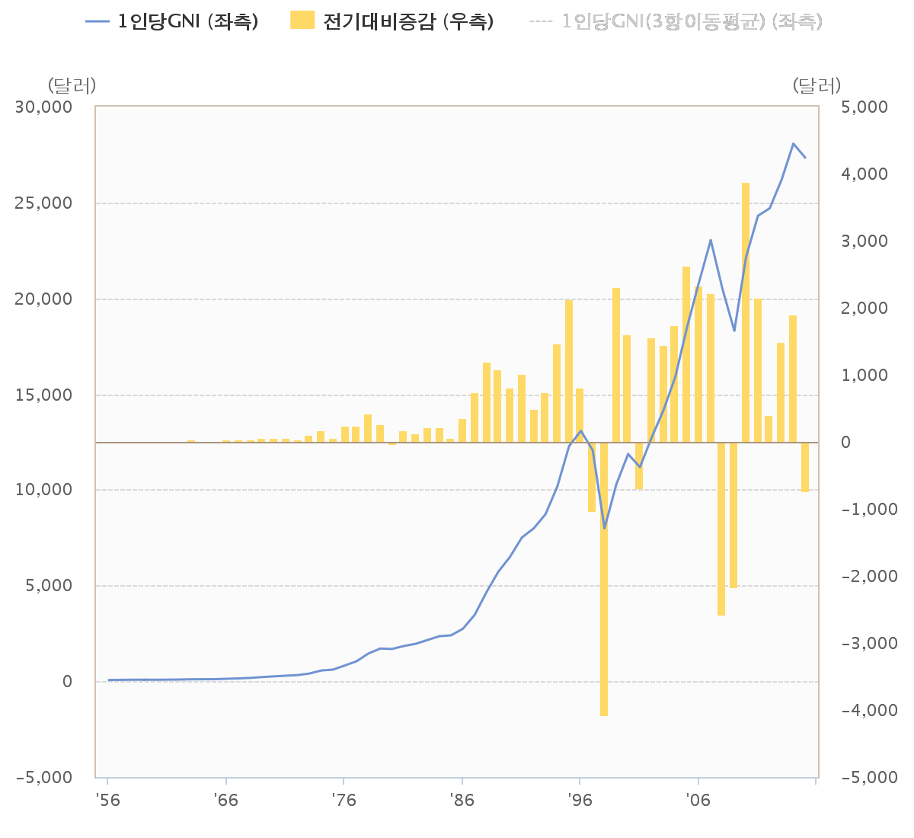
GNP per Capita(US$)
US$
07 2nd FC
98 1st FC
Year | 1956 | 1970 | 1980 | 1990 | 2000 | 2014
US$ | 67 | 255 | 1,660 | 6,303 | 11,292 | 28,180

Slide 24
NTQS
NTQS
National Technical Qualification System

Slide 25

▣ Function & Role of Vocational Qualification
1. Function
To be functioned as interface (e.g. bridge) to link between industries and educational & training institutes
Conditioning Learning
Structuring Labor Market
Education & Training
institutes
Vocational
Qualification
System
Industries
To give signals based on demands
from consumers
To receive demands
for worker’s competencies

Slide 26
Change of NTQF
Past (by 1998)
Present
Professional Engineer
Master Craftsman
Professional Engineer
Master Craftsman
1st Class Engineer
Engineer
2nd Class Engineer
1st Class Craftsman
Industrial Engineer
2nd Class Craftsman
Craftsman
Assistant Craftsman

Slide 27
Eligibility for NTQS
- Engineer＋4 years*
- University graduate
＋7 years*
- Practical Experience ;
11 years
Professional
Engineer
Master
Craftsman
- Industrial Engineer
＋6 years*
- Craftsman＋8 years*
- Practical Experience ;
11 years
- Industrial Engineer
＋1 year*
- University graduate
- Practical Experience ;
4 years
Engineer
- Craftsman＋1 year*
- Junior College graduate
- Practical Experience ;
2 years
Industrial
Engineer
Craftsman
No Limitation

Slide 28
Challenges
Challenges

Slide 29
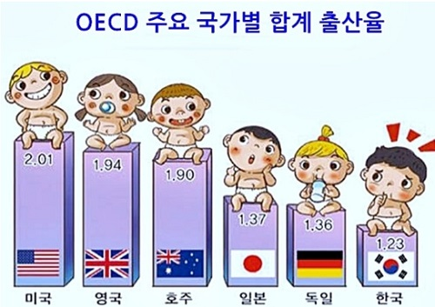




SOCIAL ISSUES
Social Issue
Youth Unemployed
Low Birth Rate+Aging
Low Economy Growth
Fierce
Competition
Polarization
Employment Instability

Slide 30
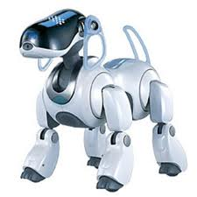

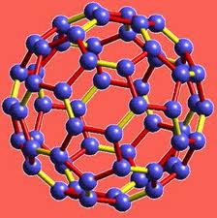


Convergence Technology
ADVANCED FUSION
SMT. BROAD
ROBOT TECH.
NANO TECH.
BIO-IT (BIT)
IT FUSION
MEDI. EUIP.
6/27

Slide 31

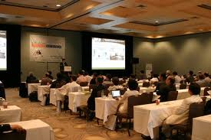
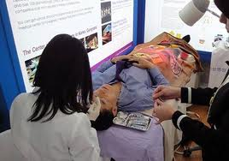

High Value Added Business Technology
HIGH VALUE
GLBL. HEALTH
SMT FINANCE
CONTENTS
SOFT WARE
GLOB. EDU-SRV
MICE TOUR

Slide 32











NCS
NCS
National Competence Standard
There is a mismatch in the market because of supplier based education
Too much waste in retraining new employees($60,000/ person)
일-교육-자격-경력-연계 강화
Improving competitiveness for the competency based society
Academic background oriented society
Competency oriented society
Education : to know
break
to be able to do
Recognition theory/Academic oriented education
Occupational oriented education
background focused social awareness
Competency based recruitment & promotion
Private education for getting a job
Trusted public education
Notes:
Distinguished participants!
As you already know, Korea has achieved a rapid economic growth, currently having the 15th largest economy in the world.
Korea has Limited area, scarce resources. Only one that we could believe in was human resources.
In the 21st century, society emphasizes on lifelong learning Knowledge and information technology changes very rapidly, Also, senior population is getting increased, We witness labor shortage and globalization, and knowledge integration that result in skills enhancement,
To recover this situation, it is critical to improve competitiveness of workers as well as enterprises though the human resource development.
SMEs are the basis of national industries, however, they are suffering with the rare HRD opportunity .
IF the competitiveness of SMEs has increased, the growth rate would be getting higher and they could make a lot of jobs to raise welfare. That is the connection between growth and employment and welfare.
The best welfare required by the times, is Human Resource Developm

Slide 33
Competency based Society Framework
Before entering labor market
(school to Work)
After entering labor market
(Work to Scholl)
Competency
Based
society
NQF
Employ
HRM
Vocational Education
(School)
Qualification system
Competency based recruitment
Competency based Assessment
Wage and Promotion by Competency
Korea Dual System
(Learning with work)
Vocational Traing
National Competency Standards (NCS)
Spread competency based society awareness
Notes:
Vocational education can be defined as education in all forms and kinds which promote the change of work-related human behavior (The Encyclopedia of Vocational Education & Training, 1999)
To enable students and workers to acquire and/or enhance knowledge, skills and attitude necessary for finding employment or successfully carrying out tasks in the workplace (Industrial Education Promotion Act and Vocational Training Promotion Act)
To provide training opportunities for enhancing professional competencies through working life to meet qualitative demand and lifelong learning needs

Slide 34
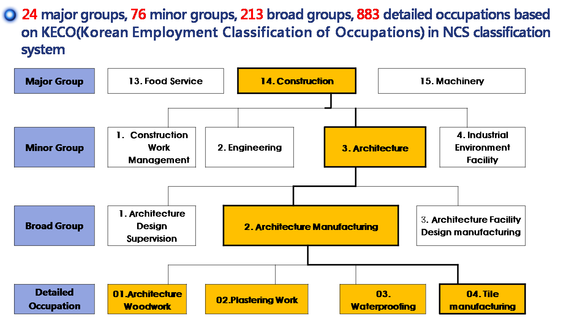
NCS Scheme
8 Levels
77
227
857

Slide 35



WBLS
Work Based Learning System
WBLS
A new paradigm of TVET
“Apprenticeship customized for Korea”
A new TVET program lead by companies, with programs based on NCS, and in-company trainers train learning workers in a company instead of school
or vocational training institutes; and be given certification by government and industry. (training duration: 1~4 yrs)
Training program based on NCS
OJT
Work + training
on site
Certificates
Employed
Assessment
& completion
Off-JT
Theory based
in school, training institutes, etc. on demand of a company
Learning-worker

Slide 36
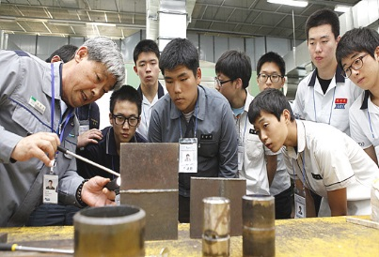

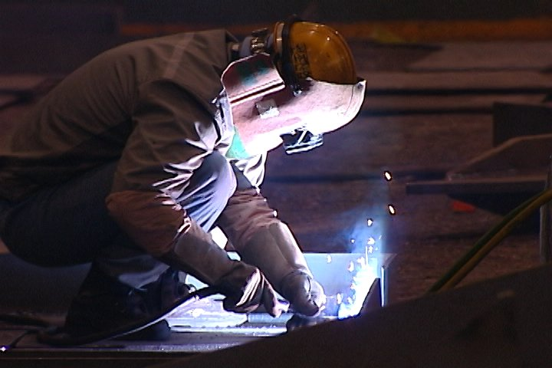

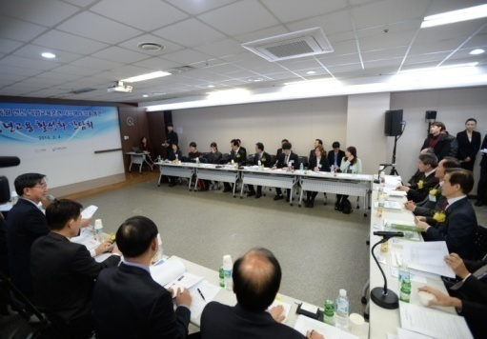
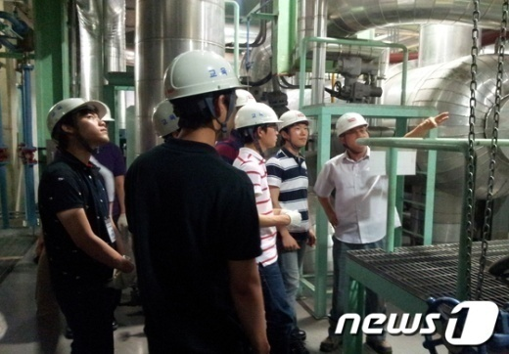
Long term goal
70,000
10,000
42,000
6,000
Learning worker
Company
5,000
1,300
20,000
3,000
’14
’15
’16
’17

Slide 37

Terima kasih
Prof. Dr. Eom Joon Chul uses an e-mail as following;
polyeom@naver.com

